Slide 1

Performance Modeling and Analysis of Design
Patterns for Microservice Systems
Aishwarya Pimplikar- 6043953850
Devanshu Shah - 1796127645
Dhiraj Shah - 5362267128
Naman Kothari - 3786602611
Siya
Pranav Kolhe - 6981095982

Slide 2
Motivation and background
Research objectives and questions
RQ1 : explain the QN pattern and the 7 patterns (problem it solves, explain)-A
RQ2: explain performance models,and again for all 7 explain the simulations, findings, Summarize which patterns improved or hurt performance in a table/visual
Practical Implications acc to the authors and Our Team’s Perspective on the practical impact
Future work suggested by paper, then our own suggestions
Critique:
• Q1 How it differs from previous research (related works can be referred)
• Q2 Appropriateness of methodology
• Q3 Validity & limitations
• Q4 Presentation quality - language and quality of paper
Conclusion & Takeaways

Slide 3
Motivation and Background
Motivation & Background:
Microservices depend heavily on design patterns
Performance impact often assumed, not measured
Most evaluations happen at runtime
No formal models to predict performance under different workloads
This Paper Aims To:
Build performance models for key microservice design patterns
Analyze how each pattern behaves under different workloads
Notes:
First 4 points:
Modern microservice systems use a lot of design patterns — things like gateways, CQRS, offloading — because we assume they make systems faster and more scalable.
But the reality is: we rarely measure that impact. Most teams just trust the pattern, and performance issues are usually found at runtime, when the system is already deployed and expensive to fix.
And let’s be honest — most of us have applied a pattern simply because it’s considered a ‘best practice,’ right? But does it really help performance? Or can it actually make things worse?
That’s exactly the motivation behind this paper. Performance matters, but we don’t actually know how each pattern behaves under different workloads. There was no formal or quantitative way (UNTIL NOW!!) to predict that.
Next 2 points:
“So what does this paper actually do? Two things, very simple: it models these patterns mathematically, and then stress-tests them under different workloads.
First, they build mathematical performance models for seven widely-used microservice design patterns. Instead of relying on intuition or best practices, they translate each pattern into a formal queueing network model.
Second, they simulate different types of workloads — fast requests, slow requests, mixed traffic — and measure things like response time and resource usage. The idea is to see whether each pattern actually improves performance, becomes a bottleneck, or maybe even hurts the system.
I know, you all must be thinking the same: Finally something that quantifies design patterns!!!!!

Slide 4
Research Objectives and Questions
Key Research Goal:
Build performance models for key microservice design patterns
Analyze how their performance changes with different workloads
Topics of Investigations:
Modeling How can these microservice design patterns be represented using queueing network models? (Goal: build accurate performance models for each pattern.)
Performance Impact How do these design patterns’ performance change under heterogeneous workloads?
(Goal: simulate, measure response time + resource usage, find bottlenecks.)
Notes:
“Now that we know the motivation, the authors turn that into two research objectives:
First, they build performance models for seven commonly used design patterns.
Second, they analyze how performance changes when workloads are mixed — because real systems never get only one type of request.”
“So they formalize this into two research questions:
RQ1: Can these microservice design patterns be modeled using queueing networks? The answer is yes — all seven patterns can be modeled this way, although one of them needed a hybrid model because it required synchronization, but we’ll talk about that shortly after.
RQ2: How do these patterns behave under heterogeneous workloads? Here they found something interesting — performance changes a lot based on the mix of requests. Some patterns behave as expected, but a few can even become bottlenecks and slow down the system.”
“So now that we have the questions and a hint of the findings… let’s dive deeper into how they actually built these models and what they discovered.”

Slide 5
RQ1: Queuing Network
RQ1: QUEUEING NETWORK
Purpose: Represent request flow & resource sharing among microservices
Elements: Service stations → microservices/resources Jobs → user requests
Station types:
Processing station: finite servers + queue (waiting + service time)
Delay station: infinite servers, no queue (models network delays)
Behavior:
Requests arrive → wait → get processed → routed to next service
Service times (S) ~ Exponential distribution Fork-Join mechanism → split requests into parallel tasks then recombine
Metrics collected: Response Time (R) & Utilization (U)
Client
Gateway
(Delay Station)
Queue
Queue
Service A
(Processing Station)
Service B
(Processing Station)
Joint Response
Notes:
RQ1 investigates how microservice design patterns can be represented through Queueing Network (QN) performance models. The goal of this modeling approach is to capture the request flow and resource sharing among microservices so that performance can be evaluated early in the design phase. In the QN setup, service stations represent the processing resources or microservices, while jobs represent the user requests circulating through the system. Two kinds of stations are used: processing stations, which have a finite number of servers and a queue to model waiting and service times; and delay stations, which have infinite servers and no queue, used to represent activities such as network or client delays.
Requests in the model arrive, wait, are processed, and then move to the next service, following the routing structure of the system. Each station’s service time (S) is assumed to follow an exponential distribution,which is standard in QN modeling. To simulate parallelism, a Fork-Join mechanism is included, allowing requests to be split into concurrent tasks—such as multiple microservice calls—and then rejoined before completing. The authors used these models to compute two key performance metrics: Response Time (R), indicating how long each request spends in the system, and Utilization (U), reflecting how intensively each microservice resource is used. This QN setup forms the foundation for modeling all seven design patterns analyzed in the study.

Slide 6
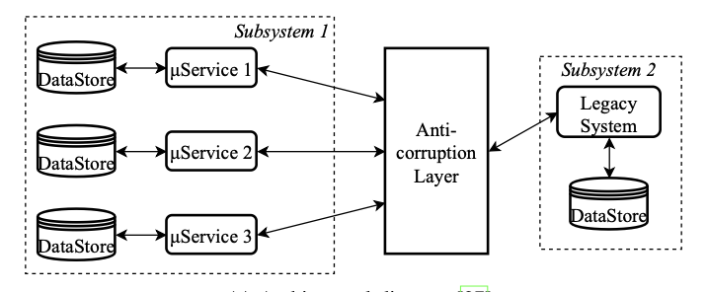
PERFORMANCE MODELS OF DESIGN PATTERNS
Anti-corruption Layer
Backends for Frontends
Command and Query Responsibility Segregation
Gateway Aggregation
Gateway Offloading
Problem
Solution
New microservices must communicate with legacy or incompatible systems, risking inconsistent data and poor integration.
Adds a translation / adapter layer between systems, ensuring clean communication — but adds slight latency overhead.
Pipe and Filters
Static Content Hosting
Notes:
let’s look at how this framework was applied to model the performance of different microservice design patterns.,The Anti-Corruption Layer pattern is used when new microservices need to communicate with older or incompatible legacy systems. Without it, data can become inconsistent and integration unreliable. This pattern introduces a translation or adapter layer between the systems to ensure clean communication , one drawback however is that it slightly increases latency due to the extra processing step.

Slide 7
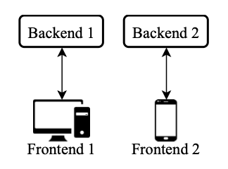
PERFORMANCE MODELS OF DESIGN PATTERNS
Anti-corruption Layer
Backends for Frontends
Command and Query Responsibility Segregation
Gateway Aggregation
Gateway Offloading
Problem
Solution
One backend serving multiple client types (web, mobile, IoT) becomes overloaded with interface-specific logic.
Provides a dedicated backend per client type, reducing complexity and improving response times for each interface.
Pipe and Filters
Static Content Hosting
Notes:
The Backends for Frontends pattern addresses the issue of a single backend serving different client types like web, mobile, or IoT. This often overloads the backend with interface-specific logic. The solution is to provide a dedicated backend for each client type, which reduces complexity and improves response times since each backend is optimized for its respective interface.

Slide 8
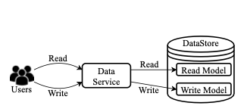
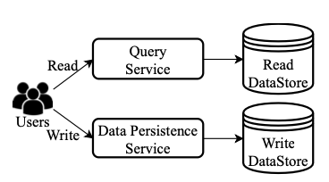
PERFORMANCE MODELS OF DESIGN PATTERNS
Anti-corruption Layer
Backends for Frontends
Command and Query Responsibility Segregation
Software Separation
Hardware Separation
Gateway Aggregation
Gateway Offloading
Problem
Solution
A single data model handling both reads and writes limits scalability and creates contention.
Splits read and write operations into separate models — either software-separated (same hardware) or hardware-separated (different nodes).
Software split improves frequent-write performance; hardware split scales better for read-heavy workloads.
Pipe and Filters
Static Content Hosting
Notes:
The CQRS pattern separates read and write operations to overcome contention from a single shared data model. It can be implemented as software separation, where read and write logic share the same hardware, or hardware separation, where they run on different nodes. The software split performs better for frequent writes, while the hardware split scales better for read-heavy workloads.

Slide 9
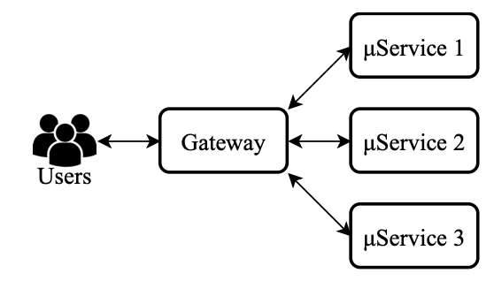
PERFORMANCE MODELS OF DESIGN PATTERNS
Anti-corruption Layer
Backends for Frontends
Command and Query Responsibility Segregation
Gateway Aggregation
Gateway Offloading
Problem
Solution
Clients must call many microservices individually, creating excessive network latency.
Introduces a gateway that aggregates multiple backend requests into a single call, cutting network overhead and speeding responses.
Pipe and Filters
Static Content Hosting
Notes:
The Gateway Aggregation pattern addresses the issue of clients needing to call multiple microservices individually, which increases network latency. By introducing a gateway that aggregates these requests into a single call, this pattern reduces network overhead and improves overall response time for the client.

Slide 10
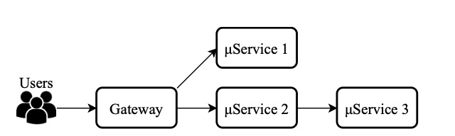
PERFORMANCE MODELS OF DESIGN PATTERNS
Anti-corruption Layer
Backends for Frontends
Command and Query Responsibility Segregation
Gateway Aggregation
Gateway Offloading
Problem
Solution
Common cross-cutting tasks (authentication, logging, caching) are duplicated across services.
Moves shared logic to a centralized gateway, reducing duplication, but can create a bottleneck if the gateway becomes overloaded.
Pipe and Filters
Static Content Hosting
Notes:
The Gateway Offloading pattern helps manage cross-cutting concerns like authentication, logging, and caching, which are often duplicated across services. It moves these shared tasks to a centralized gateway, reducing redundancy and simplifying service logic. One drawbac k here is thats can create a potential bottleneck if the gateway becomes overloaded.

Slide 11
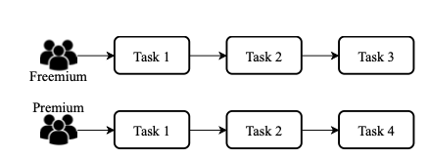
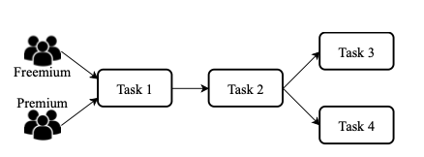
PERFORMANCE MODELS OF DESIGN PATTERNS
Anti-corruption Layer
Backends for Frontends
Command and Query Responsibility Segregation
Separated Services
Joint Services
Gateway Aggregation
Gateway Offloading
Problem
Solution
New microservices must communicate with legacy or incompatible systems, risking inconsistent data and poor integration.
Adds a translation / adapter layer between systems, ensuring clean communication — but adds slight latency overhead.
Pipe and Filters
Static Content Hosting
Notes:
The Pipes and Filters pattern structures a system as a series of processing steps, where each filter handles one task and passes its output downstream. It can be modeled as separated pipelines, where each user group has its own sequence, or as joint services, where some filters are shared. This modular approach improves reuse and enables parallel execution, enhancing overall throughput.

Slide 12
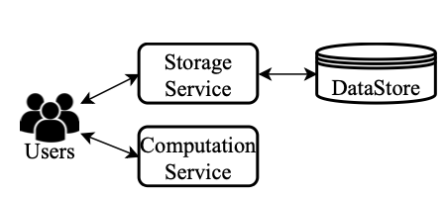
PERFORMANCE MODELS OF DESIGN PATTERNS
Anti-corruption Layer
Backends for Frontends
Command and Query Responsibility Segregation
Gateway Aggregation
Gateway Offloading
Problem
Solution
Dynamic services slow down when also serving static assets (images, CSS, videos).
Offloads static resources to specialized storage / CDN microservices, freeing compute capacity and lowering response time.
Pipe and Filters
Static Content Hosting
Notes:
The Static Content Hosting pattern separates static and dynamic workloads to improve system performance. When dynamic services also serve images, videos, or CSS files, they slow down under load. This pattern offloads static resources to specialized storage or CDN microservices, freeing up compute capacity and reducing overall response time.

Slide 13
RQ2: MODEL BASED PERFORMANCE ANALYSIS
RQ2: MODEL BASED PERFORMANCE ANALYSIS
Goal : To measure system response time (R) and resource utilization (U) for each design pattern under different workloads.
Tool Used : JSIMgraph (Java Modelling Tools) to run Queueing Network (QN) simulations for each pattern.
Average runtime per simulation ≈ 20 seconds on standard hardware (Intel i7, 16GB RAM).
Symbol | Meaning
N | Number of users
Z | Thinking time for users
S | Service time

Slide 14
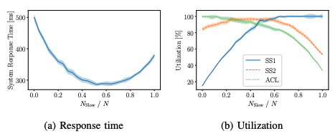
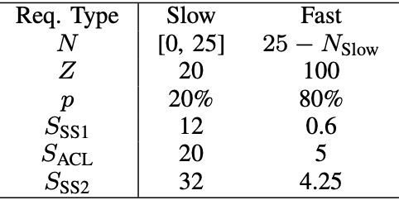
MODEL BASED PERFORMANCE ANALYSIS
Anti-corruption Layer
Backends for Frontends
Command and Query Responsibility Segregation
Gateway Aggregation
Gateway Offloading
Parameters
Finding
System performs best when there’s a balanced mix of fast and slow requests.
Too many of one type shifts the bottleneck between components (ACL, Subsystem 1, or Subsystem 2) and increases response time.
Pipe and Filters
Static Content Hosting

Slide 15
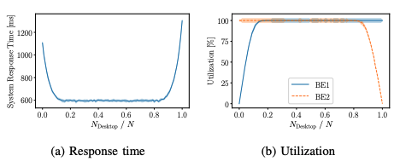
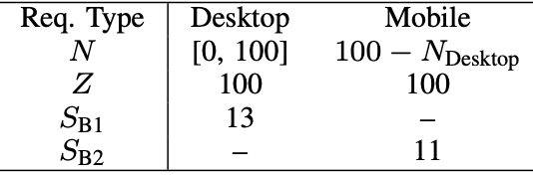
MODEL BASED PERFORMANCE ANALYSIS
Anti-corruption Layer
Backends for Frontends
Command and Query Responsibility Segregation
Gateway Aggregation
Gateway Offloading
Problem
Solution
Best performance occurs when requests are evenly split between frontends.
If one backend handles most traffic, it becomes a bottleneck and slows the system.
Pipe and Filters
Static Content Hosting

Slide 16
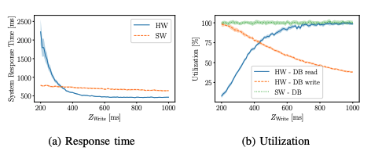
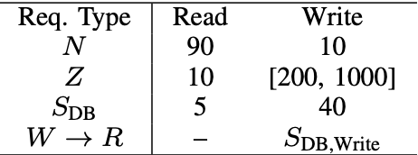
MODEL BASED PERFORMANCE ANALYSIS
Anti-corruption Layer
Backends for Frontends
Command and Query Responsibility Segregation
Gateway Aggregation
Gateway Offloading
Problem
Solution
Software separation (single DB) works better when writes are frequent.
Hardware separation (two DBs) performs better when writes are rare because sync overhead is lower.
Pipe and Filters
Static Content Hosting

Slide 17
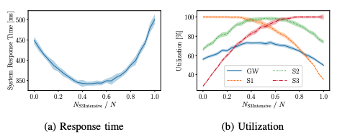
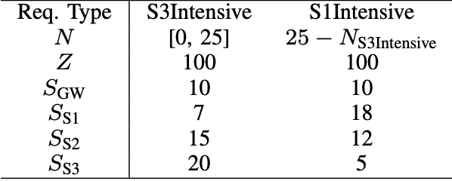
MODEL BASED PERFORMANCE ANALYSIS
Anti-corruption Layer
Backends for Frontends
Command and Query Responsibility Segregation
Gateway Aggregation
Gateway Offloading
Problem
Solution
Aggregating requests reduces communication, but bottlenecks shift among microservices depending on workload mix.
The gateway itself doesn’t limit performance — one of the services does.
Pipe and Filters
Static Content Hosting

Slide 18
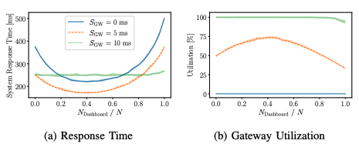
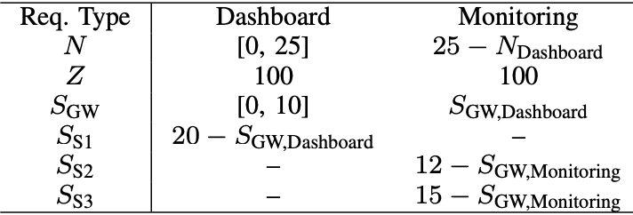
MODEL BASED PERFORMANCE ANALYSIS
Anti-corruption Layer
Backends for Frontends
Command and Query Responsibility Segregation
Gateway Aggregation
Gateway Offloading
Problem
Solution
Offloading short, common tasks improves performance.
Offloading long tasks overloads the gateway, making performance worse — it can even negate the benefit of using this pattern.
Pipe and Filters
Static Content Hosting

Slide 19
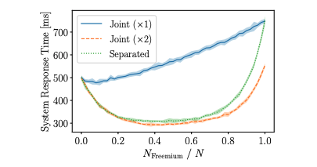
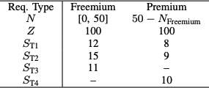
MODEL BASED PERFORMANCE ANALYSIS
Anti-corruption Layer
Backends for Frontends
Command and Query Responsibility Segregation
Gateway Aggregation
Gateway Offloading
Parameters
Solution
Shared “joint” tasks perform well only when given enough resources (e.g., 2 CPUs).
If under-provisioned, shared tasks slow everything down; duplicated services cost more but stay stable.
Pipe and Filters
Static Content Hosting

Slide 20
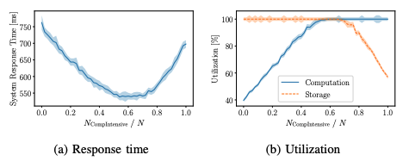

MODEL BASED PERFORMANCE ANALYSIS
Anti-corruption Layer
Backends for Frontends
Command and Query Responsibility Segregation
Gateway Aggregation
Gateway Offloading
Parameters
Solution
Best performance when compute and storage workloads are balanced.
If one side dominates, that component becomes the bottleneck, slowing responses.
Pipe and Filters
Static Content Hosting

Slide 21
The practical implications
Authors’ view (practical impact)
Pattern benefits depend on the traffic mix; test with more than one workload
CQRS: write-heavy systems can slow down due to synchronization; choose the split with care
Gateway offloading: well-suited to small, common tasks (e.g., auth, rate limits); heavy tasks can bottleneck the gateway
Backends for Frontends (BFF): if one frontend drives much more traffic, its backend can become a hotspot
Pipes and Filters: increasing capacity in shared stages can outperform duplicating entire services
Our team’s view (practical impact)
Treat patterns as adjustable levers, not one-size-fits-all solutions; run quick “what-if” checks before committing
Revisit the chosen pattern when the traffic mix changes
Tie choices to clear SLOs (e.g., P95 latency) and keep simple tuning knobs (thread pools, CPU per stage)
Start gateway offloading with lightweight tasks; measure results before moving heavier logic
Notes:
The paper’s message is simple: a pattern can be fast or slow depending on the traffic you actually have. If writes are heavy, CQRS can slow down because of syncing. Keep gateways light, do auth and rate limits there, not big business logic. With BFF, one busy app can overload its backend. In Pipes & Filters, first add capacity to the shared step.

Slide 22
FUTURE WORK
Author’s suggestions
Extend the models to cover additional qualities (e.g., reliability, availability)
Validate predictions on real systems and compare with measured results
Run practitioner studies to confirm the models aid real-world design decisions
Our suggestions
Include cost and energy in the trade-off space (speed, throughput, cost)
Model autoscaling policies and SLO targets directly
Build an SLO-aware advisor that recommends a pattern and settings for a target P95/P99
Use distributed tracing to keep model parameters accurate over time
Evaluate pattern combinations and serverless specifics (e.g., cold starts)
Notes:
From here, we’ll test the model on a real system and see if the numbers hold. We’ll look beyond speed, checking reliability and availability too, and add cost and energy to the trade-offs. We’ll model autoscaling around clear SLO targets, feed in tracing data to keep the model accurate, and build a small advisor that recommends the right pattern and settings for our target P95/P99.

Slide 23
CRITIQUE
Does the paper provide a literature review result?
Yes. The paper reviews prior research on microservice design patterns, performance monitoring, and modeling.
It cites surveys that show organizations use patterns based on belief rather than measured results.
Q1. How does this research differ from the previous research?
What are the previous research papers that the paper cites?
Q2. How appropriate is the research methodology?
Vale et al. (2022) — industry survey on design patterns usage
Heinrich et al. — microservice performance modeling is a research challenge
Research on runtime monitoring, tracing, and ML-based anomaly detection
These papers describe patterns conceptually, but none measure performance impact.
Q3. How valid is the result and interpretation?
What are the key differences that the paper contributes that the previous research papers did not?
This paper is the first to quantify how design patterns impact performance using Queueing Network models and simulations.
Prior work was descriptive or qualitative; this paper shows that some patterns improve performance while others can hurt performance (e.g., Gateway Offloading becomes a bottleneck).
Q4. How well does the paper present the research?

Slide 24
CRITIQUE
What research methodology is used?
The paper uses model-based performance evaluation, building Queueing Network (QN) models and Petri Nets (for CQRS synchronization), then running simulations using JSIMgraph.
Q1. How does this research differ from the previous research?
Is the experimental procedure or study design appropriate to answer the research question?
Q2. How appropriate is the research methodology?
Yes. The research question asks whether design patterns impact performance, and modeling + simulation allow answering this before implementation, avoiding runtime noise.
Q3. How valid is the result and interpretation?
Does the paper provide sufficient detail about the research methodology?
Yes. The paper provides full model parameters, simulation configuration, and even a replication package with all models and data.
Q4. How well does the paper present the research?

Slide 25
CRITIQUE
Is the data source reliable?
Yes. The data comes from formal performance models (Queueing Network models and Petri Nets), not opinions or ad-hoc measurements. All model parameters and workloads are explicitly defined, making the data reliable and controlled.
Q1. How does this research differ from the previous research?
Does the paper analyze the result rigorously?
Q2. How appropriate is the research methodology?
Yes. The results are analyzed using response time and resource utilization across different workload mixes, showing how bottlenecks shift when demand changes. The analysis connects the simulation output directly to the research questions.
Q3. How valid is the result and interpretation?
Does the paper provide a sound statistical analysis result?
Yes. Simulations include 99% confidence intervals to ensure statistical accuracy. The paper also documents simulation configuration, model parameters, and execution details.
Q4. How well does the paper present the research?

Slide 26
CRITIQUE
Does the paper identify potential weaknesses of the result or interpretation?
Yes. The authors clearly acknowledge limitations. They note that the models abstract away real-world complexities, parameter choices may influence results, and findings might not generalize to all microservice architectures.
Q1. How does this research differ from the previous research?
Does the paper discuss the reproducibility of the result?
Q2. How appropriate is the research methodology?
Yes. The paper provides a complete replication package that includes all performance models, the simulation files, and the parameter settings. This allows other researchers to reproduce the results and verify the findings.
Q3. How valid is the result and interpretation?
Are the conclusions supported by the evidence presented?
Yes. Performance graphs demonstrate when patterns improve performance and when they degrade it. The paper’s conclusions match the simulation results (e.g., Gateway Offloading becomes a bottleneck when too much work is pushed to it).
Q4. How well does the paper present the research?

Slide 27
CRITIQUE
Is it easy and fun to read to you?
Yes. The paper is clear and straightforward. Each pattern is explained using the same structure: problem, solution, model, and performance result. This makes the flow easy to follow.
Q1. How does this research differ from the previous research?
Are the sections well-organized?
Yes. The paper is organized logically. It moves from background, to model creation, to experiments, then to results and discussion. Each section leads naturally into the next.
Q2. How appropriate is the research methodology?
Do the figures and tables clearly demonstrate the contents?
Yes. Figures show the architecture of each pattern and how it maps to the performance model. Tables list model parameters used in the simulations. Both make the concepts clearer.
Q3. How valid is the result and interpretation?
Do the figures and tables appear necessary and add value to the overall presentation of the paper?
Q4. How well does the paper present the research?
Yes. The visuals are essential. Without them, understanding the mapping between the design pattern and its performance behavior would be difficult. The figures help the reader see how the bottlenecks form.

Slide 28
Conclusion and Takeaways
Conclusion
This paper transforms design patterns from intuition-based decisions into quantifiable, performance-driven choices
Queueing-network modeling proves to be a powerful abstraction for most microservice patterns
Performance is not static — it shifts with workload composition and bottleneck migration
Key Takeaways
Design patterns are not universally beneficial; context and workload matter
Model-based analysis enables early detection of performance risks, before deployment
Gateway Offloading can introduce performance degradation, challenging common assumptions
Formal performance modeling empowers architects to design systems based on evidence, not guesswork
Notes:
“So to conclude — this paper makes one idea very clear: design patterns should not be adopted blindly. What developers often treat as guaranteed performance improvements can, under certain workloads, become bottlenecks.”
“The authors show that queueing-network models are not only feasible, but highly effective for representing microservice patterns. With these models, we can predict response times, identify bottlenecks, and evaluate trade-offs long before deployment.”
“A key observation is that performance depends heavily on workload composition. As the mix of requests changes, the system’s bottleneck shifts — and a pattern that appears beneficial under one workload can be harmful under another. Gateway Offloading is a perfect example: a pattern commonly believed to improve performance can actually slow the system down.”
“Ultimately, this work moves microservice design from assumption to evidence. It empowers architects to make performance-aware decisions early in the lifecycle, saving cost, time, and operational pain.”

